Slide 1















1
WELCOME
AWARDS
10 YEARS CELEBRATING DEI
FRAMING DE+I FUTURES

Slide 2

1
AWARDS 2025
10 YEARS CELEBRATING DEI
Business Category

Slide 3


1
AWARDS 2025
10 YEARS CELEBRATING DEI
Business Category Nominees
RISE – Empowering Women in Technology by Atturra
Balanced Workforce by Axe Group
DuluxGroup IT&DE DEI Initiative by DuluxGroup
Getmee AI Empowering Inclusive Employability Pathways by Getmee AI
Press Play Ventures - Pre-Accelerator Program for Women by Jumpstart Studio, Vox360, NiceTo & Evander Strategy

Slide 4
1
AWARDS 2025
10 YEARS CELEBRATING DEI
Business Category Nominees
Kaleida's Career Passport by Kaleida
Kinetic IT’s Katalyst Podcast: Women, Work and What's Next by Kinetic IT
Kinetic IT Belonging Framework by Kinetic IT
IT's Her Future by KPMG

Slide 5
1
AWARDS 2025
10 YEARS CELEBRATING DEI
Business Category Nominees
Maestro - Reimagining the way the world works by Maestro
Inclusion and Connection across generations - Motorola Solutions Young Professionals Group by Motorola Solutions Australia
Building Inclusive Startup Pathways for Underrepresented Tech Founders by Press Play Ventures
IT Engagement Club by Probe CX

Slide 6
1
AWARDS 2025
10 YEARS CELEBRATING DEI
Business Category Nominees
T-EDI Standards by Project F Australia Pty Ltd
Queer Town: Supporting a Gender Transition at Novatti by Queer Town
Telstra's Inaugural Culture, Ethnicity and Race Action Plan by Telstra
Trideca's Women in Technology Program by Trideca
AWS She Builds Mentorship Program by Amazon Web Services

Slide 7
1
AWARDS 2025
10 YEARS CELEBRATING DEI
Business Category
Merit Recipients

Slide 8






1
AWARDS 2025
10 YEARS CELEBRATING DEI
Queer Town: Supporting a Gender Transition at Novatti
By Queer Town
Business Category Merit Recipient

Slide 9
1
AWARDS 2025
10 YEARS CELEBRATING DEI
DuluxGroup IT&DE DEI Initiative
By DuluxGroup
Business Category Merit Recipient

Slide 10
1
AWARDS 2025
10 YEARS CELEBRATING DEI
Press Play Ventures
PreAccelerator Program for Women
By Jumpstart Studio, Vox360, NiceTo& Evander Strategy
Business Category Merit Recipient

Slide 11
1
AWARDS 2025
10 YEARS CELEBRATING DEI
Telstra's Inaugural Culture, Ethnicity and Race Action Plan
By Telstra
Business Category Merit Recipient

Slide 12
1
AWARDS 2025
10 YEARS CELEBRATING DEI
Business Category
Winner

Slide 13



1
AWARDS 2025
10 YEARS CELEBRATING DEI
Press Play Ventures
PreAccelerator Program for Women
By Jumpstart Studio, Vox360, NiceTo & Evander Strategy
Business Category Winner

Slide 14

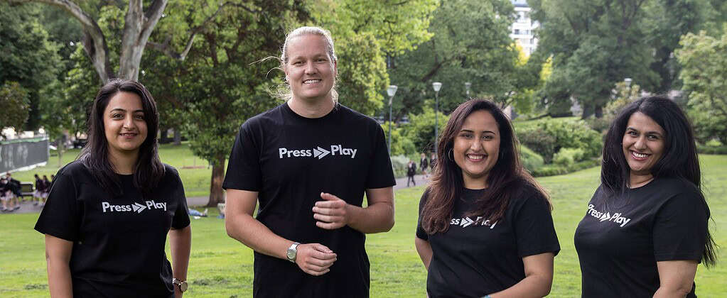
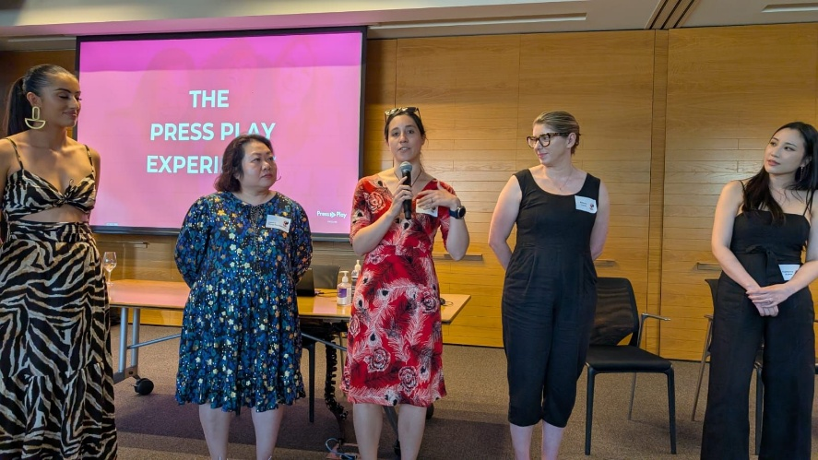
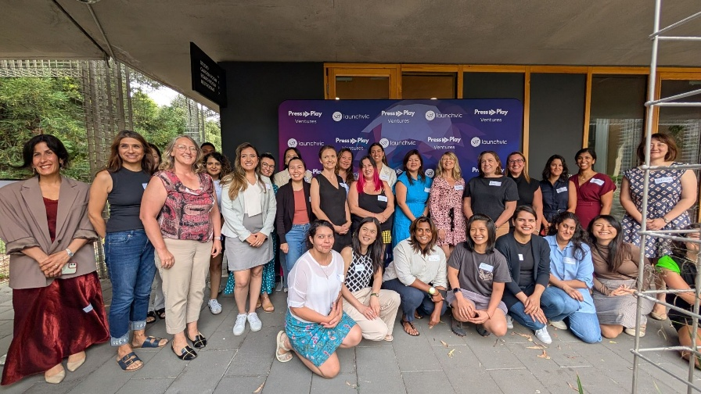
1
AWARDS 2025
10 YEARS CELEBRATING DEI
Business Category Winner
Press Play Ventures
PreAccelerator Program for Women
By Jumpstart Studio, Vox360, NiceTo& Evander Strategy
Press Play Ventures is a pre-accelerator helping women transition from employment into entrepreneurship.
Pictures are from Press Play Ventures Website and LinkedIn

Slide 15
1
AWARDS 2025
10 YEARS CELEBRATING DEI
Education Category

Slide 16
1
AWARDS 2025
10 YEARS CELEBRATING DEI
Education Category Nominees
Indigitech Bridging the Digital Divide in New Zealand's Education Sector by Amazon Web Services, Intel, Lancom, Education Perfect, and Code Avengers
AI in Action: From Curiosity to Capability for Everyone by Australian Institute for Machine Learning (AIML); Centre for Augmented Reasoning (CAR); The University of Adelaide
Deadly Coders Academy by Deadly Coders, ANZ, EdTech Group
MyAMES Chat: Empowering Language, Literacy, and Employability Skills Through AI Innovation by Getmee and AMES Australia

Slide 17
1
AWARDS 2025
10 YEARS CELEBRATING DEI
Education Category Nominees
Career Catalyst: Kinetic IT’s STEM Impact in Action by Kinetic IT
IT’s Her Future by KPMG
AI Amplified Academy by Year13, Microsoft and KPMG
Press Play Ventures - Pre-Accelerator Program for Women by Jumpstart Studio, Vox360, NiceTo & Evander Strategy

Slide 18
1
AWARDS 2025
10 YEARS CELEBRATING DEI
Education Category Nominees
Energy Efficiency with Sustainable Performance by Erlangen National High Performance Computing Center (NHR@FAU)
My initiatives Advancing Women in HPC (WHPC) Objectives by Erlangen National High Performance Computing Center (NHR@FAU)
FutureTech: Reimagining Education for Neurodivergent Youth by Futuretech Australia Incorporated
Wallara and Monash STEAM Education Program for People with Disabilities by Monash University and Wallara

Slide 19
1
AWARDS 2025
10 YEARS CELEBRATING DEI
Education Category Nominees
RefugeesCode Melbourne by RefugeesCode Melbourne
HyroBot Rumble Challenge by STEM Hub: Accelerating Diversity Through STEM by STEM Hub in collaboration with the Australian Grand Prix Corporation (event partner) Sponsored by BAE Systems Australia
BoostHer by The University of Queensland and BoostHer

Slide 20
1
AWARDS 2025
10 YEARS CELEBRATING DEI
Education Category
Merit Recipients

Slide 21
1
AWARDS 2025
10 YEARS CELEBRATING DEI
FutureTech:Reimagining Education for Neurodivergent Youth
By FutureTech Australia Incorporated
Education Category Merit Recipient

Slide 22
1
AWARDS 2025
10 YEARS CELEBRATING DEI
Indigitech Bridging the Digital Divide in New Zealand's Education Sector
By Amazon Web Services, Intel, Lancom, Education Perfect, and Code Avengers
Education Category Merit Recipient

Slide 23
1
AWARDS 2025
10 YEARS CELEBRATING DEI
MyAMES Chat: Empowering Language, Literacy, and Employability Skills Through AI Innovation
By Getmee and AMES Australia
Education Category Merit Recipient

Slide 24
1
AWARDS 2025
10 YEARS CELEBRATING DEI
Press Play Ventures
PreAccelerator Program for Women
By Jumpstart Studio, Vox360, NiceTo& Evander Strategy
Education Category Merit Recipient

Slide 25
1
AWARDS 2025
10 YEARS CELEBRATING DEI
Education Category
Winner

Slide 26
1
AWARDS 2025
10 YEARS CELEBRATING DEI
FutureTech:Reimagining Education for Neurodivergent Youth
By FutureTech Australia Incorporated
Education Category Winner

Slide 27
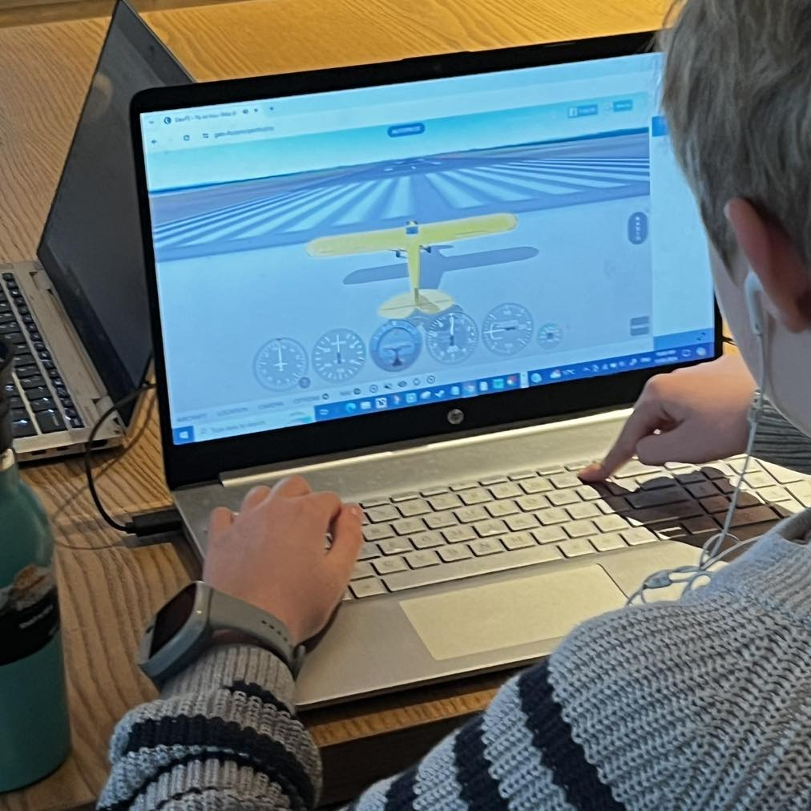
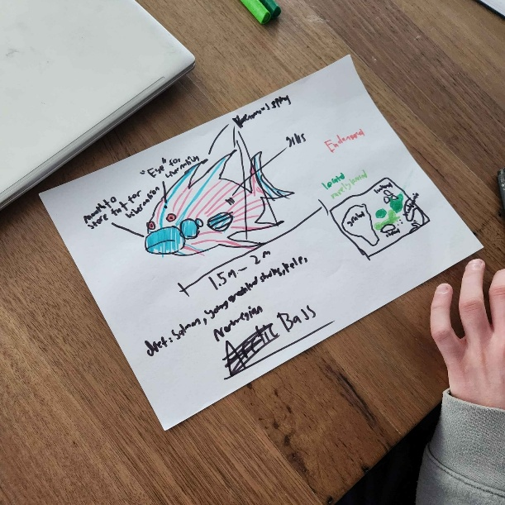
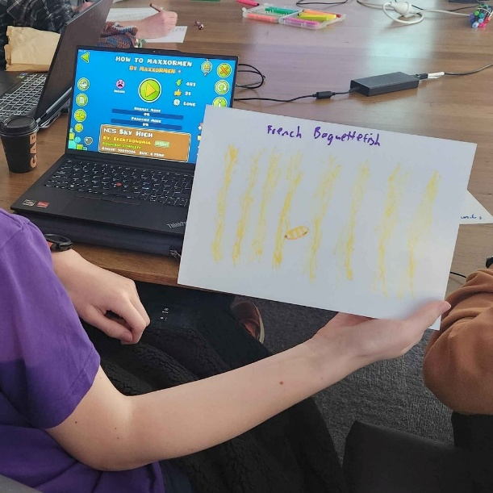

1
AWARDS 2025
10 YEARS CELEBRATING DEI
Education Category Winner
FutureTech: Reimagining Education
for Neurodivergent Youth
By FutureTech Australia Incorporated
FutureTech is a neurodivergent-led social enterprise transforming STEAM education for neurodivergent youth.
Pictures are from FutureTech Facebook Page

Slide 28
1
AWARDS 2025
10 YEARS CELEBRATING DEI
Government Category
Nominees

Slide 29
1
AWARDS 2025
10 YEARS CELEBRATING DEI
Government Category Nominees
ACT Education Directorate by ACT Education Directorate
Disability Discrimination Act: Guidelines on Equal Access to Digital Goods and Services by Australian Human Rights Commission and Intopia
Creating a culture of inclusion: DCJ’s Accessible Communications Framework by Department of Communities and Justice
Getmee AI Empowering Inclusive Employability Pathways by Getmee AI

Slide 30
1
AWARDS 2025
10 YEARS CELEBRATING DEI
Government Category Nominees
MyAMES Chat: Empowering Language, Literacy, and Employability Skills Through AI Innovation by Getmee and AMES Australia
Press Play Ventures - Pre-Accelerator Program for Women by Jumpstart Studio, Vox360, NiceTo & Evander Strategy
UpLift AI: AI-Enhanced Mental Health Care for Government Debt Relief Programs by UpLift AI
Digital Accessibility and Inclusion by Victorian Public Service - Enablers Network

Slide 31
1
AWARDS 2025
10 YEARS CELEBRATING DEI
Government Category
Merit Recipients

Slide 32
1
AWARDS 2025
10 YEARS CELEBRATING DEI
Press Play Ventures
PreAccelerator Program for Women
By Jumpstart Studio, Vox360, NiceTo& Evander Strategy
Government Category Merit Recipient

Slide 33
1
AWARDS 2025
10 YEARS CELEBRATING DEI
MyAMES Chat: Empowering Language, Literacy, and Employability Skills Through AI Innovation
By Getmee and AMES Australia
Government Category Merit Recipient

Slide 34
1
AWARDS 2025
10 YEARS CELEBRATING DEI
UpLift AI: AI-Enhanced Mental Health Care for Government Debt Relief Programs
By UpLift AI
Government Category Merit Recipient

Slide 35
1
AWARDS 2025
10 YEARS CELEBRATING DEI
Creating a culture of inclusion: DCJ’s Accessible Communications Framework
By Department of Communities
and Justice
Government Category Merit Recipient

Slide 36
1
AWARDS 2025
10 YEARS CELEBRATING DEI
Government Category
Winner

Slide 37
1
AWARDS 2025
10 YEARS CELEBRATING DEI
MyAMES Chat: Empowering Language, Literacy, and Employability Skills Through AI Innovation
By Getmee and AMES Australia
Government Category Winner

Slide 38

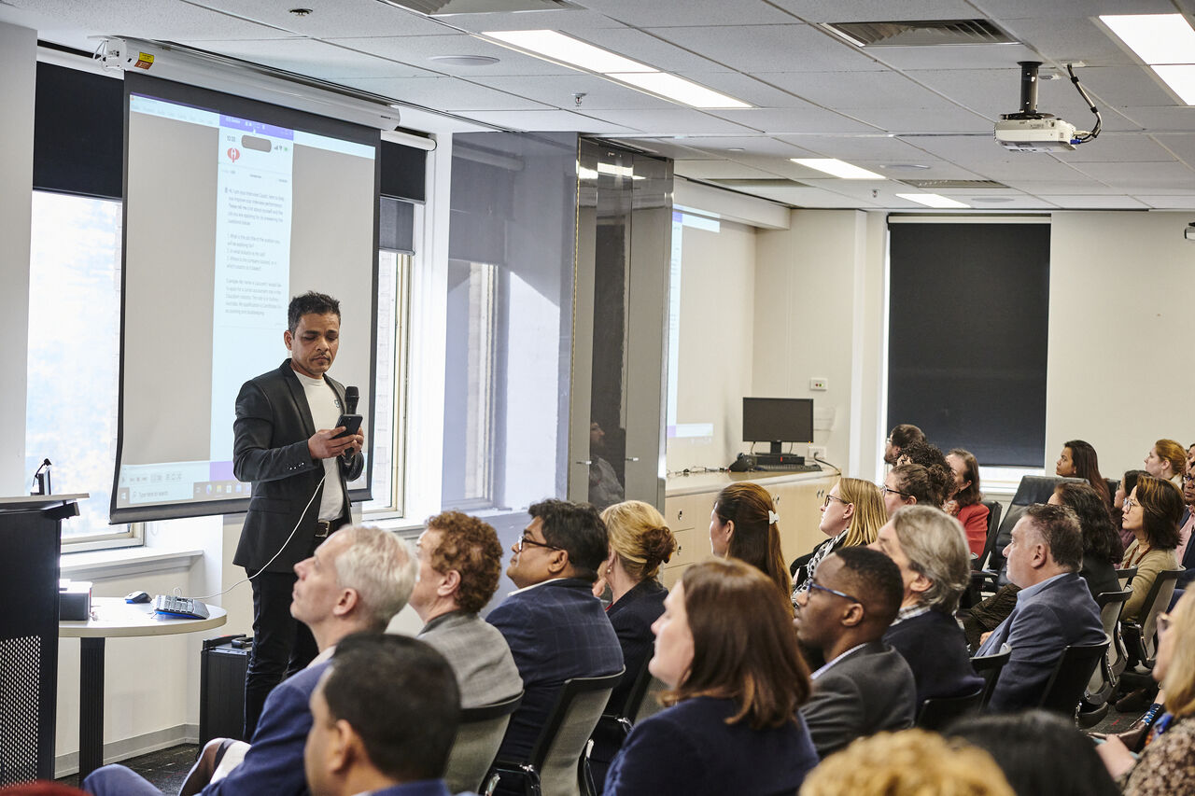
1
AWARDS 2025
10 YEARS CELEBRATING DEI
Government Category Winner
MyAMES Chat: Empowering Language, Literacy, and Employability Skills Through AI Innovation
By Getmee and AMES Australia
MyAMES Chat, powered by Getmee AI technology, revolutionises foundation skills education by offering personalised, accessible, real-time coaching to English as an Additional Language (EAL) learners.
Pictures are from the submissions in the nomination portal

Slide 39
1
AWARDS 2025
10 YEARS CELEBRATING DEI
Campaign of the Year

Slide 40
1
AWARDS 2025
10 YEARS CELEBRATING DEI
Campaign of the Year
Nominees

Slide 41
1
AWARDS 2025
10 YEARS CELEBRATING DEI
Campaign of the Year Nominees
Australia’s Diversity Drives Business Impact: Qudos Bank Arena’s Multicultural Marketing and Engagement by CulturalPulse and Qudos Bank Arena
Speaking the language: Dementia Australia’s multilingual campaign to support our Culturally and Linguistically Diverse community by Dementia Australia
Getmee AI Empowering Youth and Migrants into Work by Getmee AI
2024 Virtual Engineers Summit by Code Like a Girl
Inclusee's KIND Project by Inclusee

Slide 42
1
AWARDS 2025
10 YEARS CELEBRATING DEI
Campaign of the Year Nominees
Kinetic IT's 2025 IWD Campaign by Kinetic IT
Mo Works: Flipping the narrative on vaping for Aboriginal and Torres Strait Islander youth by Mo Works, Victorian Aboriginal Health Service
HyroBot Rumble Challenge by STEM Hub: Accelerating Diversity Through STEM by STEM Hub in collaboration with the Australian Grand Prix Corporation (event partner) Sponsored by BAE Systems Australia
Changing the landscape by Today, Our Watch, Women with Disabilities Victoria
20 year's of championing diversity by Women 4 STEM

Slide 43
1
AWARDS 2025
10 YEARS CELEBRATING DEI
Campaign of the Year
Merit Recipients

Slide 44
1
AWARDS 2025
10 YEARS CELEBRATING DEI
2024 Virtual
Engineers Summit
By Code Like a Girl
Campaign of the Year Merit Recipient

Slide 45
1
AWARDS 2025
10 YEARS CELEBRATING DEI
HyroBot Rumble Challenge by STEM Hub: Accelerating Diversity Through STEM
By STEM Hub in collaboration with the Australian Grand Prix Corporation (Event Partner) Sponsored by BAE Systems Australia
Campaign of the Year Merit Recipient

Slide 46
1
AWARDS 2025
10 YEARS CELEBRATING DEI
Australia’s Diversity Drives Business Impact: Qudos Bank Arena’s Multicultural Marketing and Engagement
By CulturalPulse and Qudos Bank Arena
Campaign of the Year Merit Recipient

Slide 47
1
AWARDS 2025
10 YEARS CELEBRATING DEI
Speaking the language: Dementia Australia’s multilingual campaign to support our Culturally and Linguistically Diverse community
By Dementia Australia
Campaign of the Year Merit Recipient

Slide 48
1
AWARDS 2025
10 YEARS CELEBRATING DEI
Campaign of the Year
Winner

Slide 49
1
AWARDS 2025
10 YEARS CELEBRATING DEI
HyroBot Rumble Challenge by STEM Hub: Accelerating Diversity Through STEM
By STEM Hub in collaboration with the Australian Grand Prix Corporation (Event Partner) Sponsored by BAE Systems Australia
Campaign of the Year Winner

Slide 50



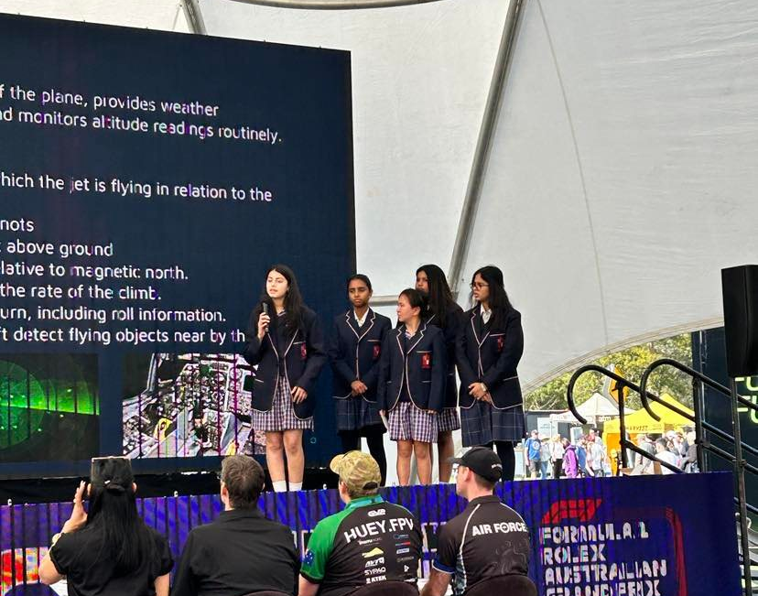
1
AWARDS 2025
10 YEARS CELEBRATING DEI
Campaign of the Year Winner
HyroBot Rumble Challenge by STEM Hub: Accelerating Diversity Through STEM By STEM Hub in collaboration with the Australian Grand Prix Corporation (Event Partner) Sponsored by BAE Systems Australia
The campaign promoting STEM Hub’s 2024 HyroBot Rumble Challenge used social media, paid ads, and school posters to drive national engagement in a STEM initiative aligned with the Australian motorsport industry.
Pictures are from the submissions in the nomination portal and from their Facebook Page

Slide 51
1
AWARDS 2025
10 YEARS CELEBRATING DEI
Tech for Good
Nominees

Slide 52
1
AWARDS 2025
10 YEARS CELEBRATING DEI
Tech for Good Nominees
Accessible home ownership for all – By Co-operty
Cérge Companion Technologies: Building an Accessible Future – By Cérge
Chanel Roistacher – By Chanel Roistacher
Circletalk App – By Circletalk Australia
CommBox: Green AV for Sustainable, Inclusive Classrooms – Technology for People and Planet – By CommBox

Slide 53
1
AWARDS 2025
10 YEARS CELEBRATING DEI
Tech for Good Nominees
Cybermate – By Cybermate
Deadly Coders Online – By Deadly Coders, EdTech Group, Kazacos AI
Enabling EDIE – By Dementia Australia
FrontYa: Unlocking Homeownership Through Tech-Enabled Equity Partnerships – By FrontYa Pty Ltd
Getmee AI Empowering Inclusive Employability Pathways – By Getmee AI
InnerSteps – By InnerSteps

Slide 54
1
AWARDS 2025
10 YEARS CELEBRATING DEI
Tech for Good Nominees
Intopia Learn – By Intopia
DEIR.AI – By ISTEM CONSULTING PTY LIMITED /DEIR PTY LIMITED
Jaimee AI – By Jaimee AI
Kaboose – By Kaboose
Code and Country: Kirra Academy’s Mission for Inclusive Tech Empowerment – By Kirra Services & Kirra Academy

Slide 55
1
AWARDS 2025
10 YEARS CELEBRATING DEI
Tech for Good Nominees
Kismet Healthcare – Revolutionising access to healthcare and disability services – By Kismet Healthcare
KPMG's 10by30 Initiative – By KPMG
Metluma – By Metluma
Mo Works: Flipping the narrative on vaping for Aboriginal and Torres Strait Islander youth – By Mo Works, Victorian Aboriginal Health Service
Wallara and Monash Mobile STEAM Maker Van Program – By Monash University and Wallara

Slide 56
1
AWARDS 2025
10 YEARS CELEBRATING DEI
Tech for Good Nominees
Nabu.ai - the digital health advocate for patients, carers and providers improving outcomes in complex care – By Nabu.ai
See the Way: AR for Neurodivergent Commuters – By NCS Australia
NSLHD Virtual Care and Hospital in the Home Services – By NSLHD Virtual Care Service and Stewart House
Democratising Leadership Development: Equity, Access and Impact at Scale – By PEEPLCOACH

Slide 57
1
AWARDS 2025
10 YEARS CELEBRATING DEI
Tech for Good Nominees
Democratising Leadership Development: Equity, Access and Impact at Scale – By PEEPLCOACH
LGBTIQA+ 101: Queer Town's Workplace Inclusion e-Learning Module – By Queer Town
Red Dirt Robotics – By Red Dirt Robotics
Technical Support – By Ryanair Airlines
SafeSpace@elevate – By SafeSpace@elevate
SAYFE – By SAYFE PTY LTD
Chanel Roistacher – By Services Australia
The Mindful CIO - Community & Podcast – By The Mindful CIO Community

Slide 58
1
AWARDS 2025
10 YEARS CELEBRATING DEI
Tech for Good Nominees
No Money No Time - a website for those with limited resources to improve nutrition – By University of Newcastle
UpLift AI: Inclusive Mental Health Innovation – By UpLift AI Group
UpLift AI: Empowering Mental Health for Lasting Social Impact – By UpLift AI Group Pty Ltd
UpLift AI: Mental Health Innovation for All Abilities and Identities – By UpLift AI Group Pty Ltd

Slide 59
1
AWARDS 2025
10 YEARS CELEBRATING DEI
Tech for Good Nominees
Understanding Zoe Untangling the Complexity of Neurodivergence – By Understanding Zoe
How V2 AI Helped Dossy Revolutionise Elder Care with a Tech-Driven Solution – By V2 AI & Dossy
Make it easy App – By We Make It Easy Pty Ltd

Slide 60
1
AWARDS 2025
10 YEARS CELEBRATING DEI
Tech for Good
Merit Recipients

Slide 61
1
AWARDS 2025
10 YEARS CELEBRATING DEI
Make it easy App - We Make It Easy Pty Ltd
Tech for Good Merit Recipient

Slide 62
1
AWARDS 2025
10 YEARS CELEBRATING DEI
CommBox:
Green AV for Sustainable, Inclusive Classrooms – Technology
for People and Planet
By CommBox
Tech for Good Merit Recipient

Slide 63
1
AWARDS 2025
10 YEARS CELEBRATING DEI
Mo Works: Flipping the narrative on vaping for Aboriginal and Torres Strait Islander youth
By Mo Works, Victorian Aboriginal Health Service
Tech for Good Merit Recipient

Slide 64
1
AWARDS 2025
10 YEARS CELEBRATING DEI
DEIR.AI
By iSTEM Consulting Pty Limited/DEIR Pty Limited
Tech for Good Merit Recipient

Slide 65
1
AWARDS 2025
10 YEARS CELEBRATING DEI
Deadly Coders Online
By Deadly Coders, EdTech Group, Kazacos AI
Tech for Good Merit Recipient

Slide 66
1
AWARDS 2025
10 YEARS CELEBRATING DEI
Cérge Companion Technologies: Building an Accessible Future
By Cérge
Tech for Good Merit Recipient

Slide 67
1
AWARDS 2025
10 YEARS CELEBRATING DEI
Tech for Good
Winner

Slide 68
1
AWARDS 2025
10 YEARS CELEBRATING DEI
Make it easy App
We Make It Easy Pty Ltd
Tech for Good Winner

Slide 69
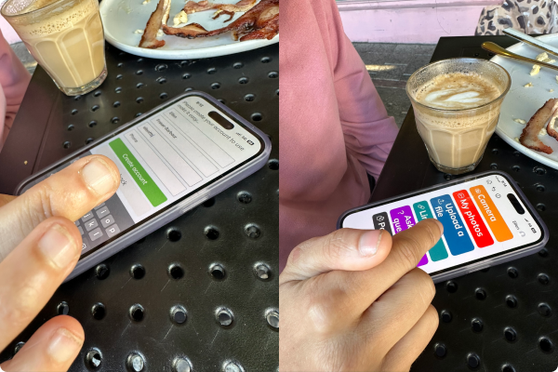

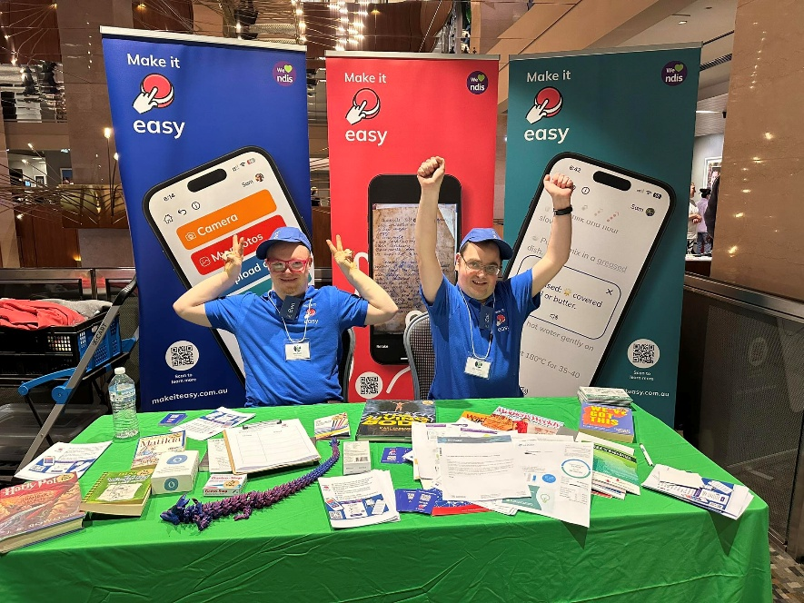
1
AWARDS 2025
10 YEARS CELEBRATING DEI
Tech for Good Winner
Make it easy App
By We Make It Easy Pty Ltd
Make It Easy is an app that transforms complex information into Easy English, Easy Read, or Plain English for people with low literacy, intellectual disability, or language barriers.
Pictures are from the submissions in the nomination portal and from their website and Facebook page

Slide 70

1
AWARDS 2025
10 YEARS CELEBRATING DEI
Announcing the 2025
TechDiversity Champion!

Slide 71
1
AWARDS 2025
10 YEARS CELEBRATING DEI
Make it easy App
By We Make It Easy Pty Ltd
CHAMPION

Slide 72

1
AWARDS 2025
10 YEARS CELEBRATING DEI
THANK YOU ALL!

Slide 73


1
AWARDS
10 YEARS CELEBRATING DEI

Slide 74
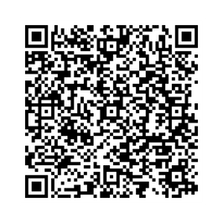
1
AWARDS 2025
10 YEARS CELEBRATING DEI
Check Out the TechDiversity Awards e-Booklet now!
Scan here

